Slide 1

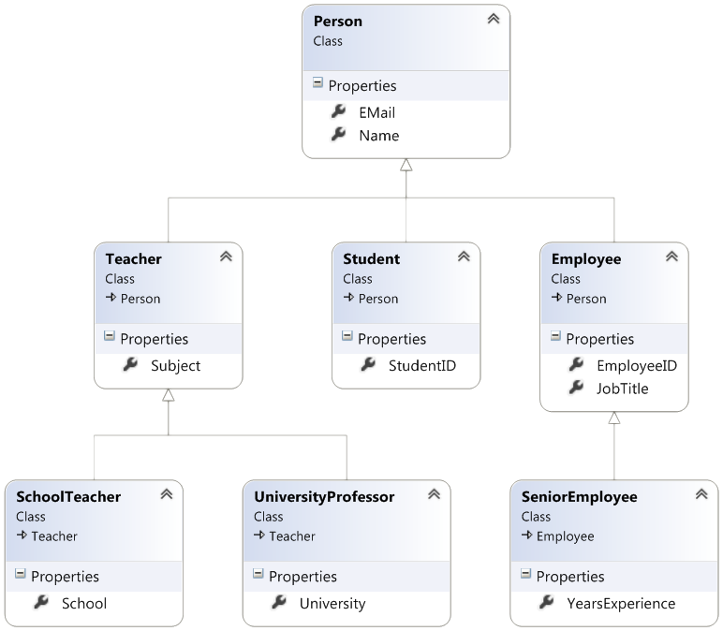


Inheritance
Class Hierarchies
C# OOP
Basics
SoftUni Team
Technical Trainers
Software University
http://softuni.bg

Slide 2

Table of Contents
Inheritance
Class Hierarchies
Inheritance in C#
Accessing Members of the Base Class
When to Use Inheritance
Composition

Slide 3
Questions
sli.do #CSharp-Fund

Slide 4
Inheritance
Superclass - Parent class, Base Class
The class giving its members to its child class
Subclass - Child class, Derived class
The class taking members from its base class
Base
Superclass
Derived
Subclass

Slide 5
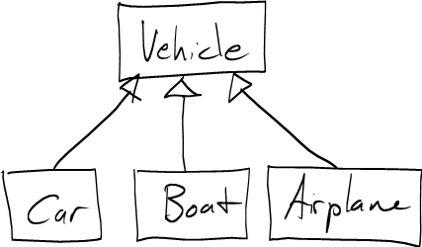
Inheritance
Extending Classes

Slide 6
Inheritance – Example
Base class
Person
+Name: string
+Address: string
Derived class
Derived class
Employee
Student
+Company: string
+School: string

Slide 7
Class Hierarchies
Inheritance leads to hierarchies of classes and/or interfaces in an application:
Base class holds common characteristics
Game
SinglePlayerGame
MultiplePlayersGame
Minesweeper
Solitaire
BoardGame
…
…
Chess
Backgammon

Slide 8
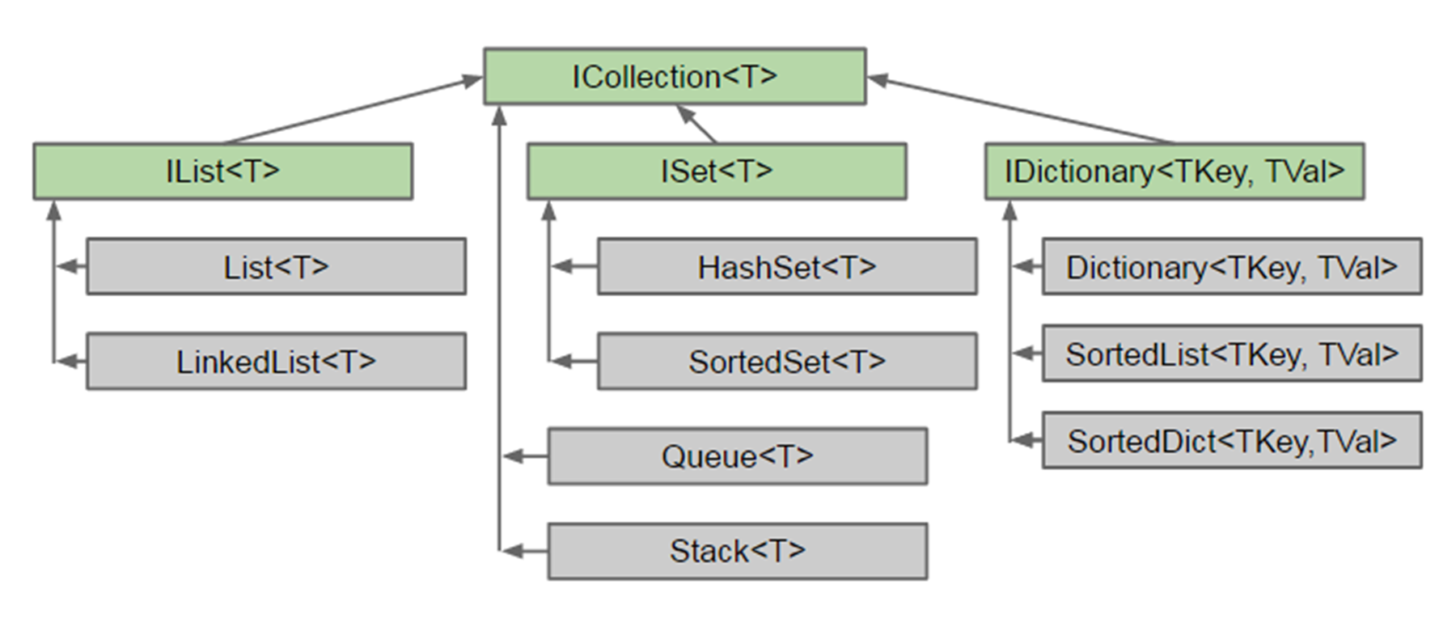
Class Hierarchies – C# Collection

Slide 9
Inheritance in C#
In C# inheritance is defined by the : operator
class Person { … }
class Student : Person { … }
class Employee : Person { … }
Person
Student : Person
Student
Employee
Notes:
Extensibility / Polymorphism: New functionality may be easily plugged in without changing existing classes as long the new plug-in classes extend given base classes.
Reusability: For a set of similar applications a framework can be defined using a core set of classes that are to be extended by classes that fill in the application-dependent part.
Information Hiding: If a more general class using a simpler contract is sufficient, details from extending classes may be hidden to some of the client classes. This allows them to be more independent from possible changes and diminishes the load of contracts that must be understood by a reader of these client classes.
(c) 2006 National Academy for Software Development - http://academy.devbg.org*
9##

Slide 10
Inheritance - Derived Class
Derived classes take all members from base classes
Reusing Person
Person
Mother : Person
Father : Person
Reusing Employee
Reusing Student
Student : Person
Employee : Person
Online
Onsite
Contract
Civil

Slide 11
Using Inherited Members
You can access inherited members as usual
class Person { public void Sleep() { … } }
class Student : Person { … }
class Employee : Person { … }
Student student = new Student();
student.Sleep();
Employee employee = new Employee();
employee.Sleep();
Notes:
Extensibility / Polymorphism: New functionality may be easily plugged in without changing existing classes as long the new plug-in classes extend given base classes.
Reusability: For a set of similar applications a framework can be defined using a core set of classes that are to be extended by classes that fill in the application-dependent part.
Information Hiding: If a more general class using a simpler contract is sufficient, details from extending classes may be hidden to some of the client classes. This allows them to be more independent from possible changes and diminishes the load of contracts that must be understood by a reader of these client classes.
(c) 2006 National Academy for Software Development - http://academy.devbg.org*
11##

Slide 12
Reusing Constructors
Constructors are not inherited
Constructors can be reused by the child classes
class Student : Person
{
private School school;
public Student(String name, School school)
:base(name)
{
this.school = school;
}
}
Notes:
Extensibility / Polymorphism: New functionality may be easily plugged in without changing existing classes as long the new plug-in classes extend given base classes.
Reusability: For a set of similar applications a framework can be defined using a core set of classes that are to be extended by classes that fill in the application-dependent part.
Information Hiding: If a more general class using a simpler contract is sufficient, details from extending classes may be hidden to some of the client classes. This allows them to be more independent from possible changes and diminishes the load of contracts that must be understood by a reader of these client classes.
(c) 2006 National Academy for Software Development - http://academy.devbg.org*
12##

Slide 13
Thinking About Inheritance - Extends
Derived class instance contains instance of its base class
Student (Derived Class)
+Study():void
Employee (Derived Class)
+Work():void
Person (Base Class)
+Sleep():void

Slide 14
Inheritance
Inheritance has a transitive relation
class Person { … }
class Student : Person { … }
class CollegeStudent : Student { … }
Person
Student
CollegeStudent
Notes:
Extensibility / Polymorphism: New functionality may be easily plugged in without changing existing classes as long the new plug-in classes extend given base classes.
Reusability: For a set of similar applications a framework can be defined using a core set of classes that are to be extended by classes that fill in the application-dependent part.
Information Hiding: If a more general class using a simpler contract is sufficient, details from extending classes may be hidden to some of the client classes. This allows them to be more independent from possible changes and diminishes the load of contracts that must be understood by a reader of these client classes.
(c) 2006 National Academy for Software Development - http://academy.devbg.org*
14##

Slide 15
Multiple Inheritance
In C# there is no multiple inheritance
Only multiple interfaces can be implemented
Person
Student
CollegeStudent
Notes:
Extensibility / Polymorphism: New functionality may be easily plugged in without changing existing classes as long the new plug-in classes extend given base classes.
Reusability: For a set of similar applications a framework can be defined using a core set of classes that are to be extended by classes that fill in the application-dependent part.
Information Hiding: If a more general class using a simpler contract is sufficient, details from extending classes may be hidden to some of the client classes. This allows them to be more independent from possible changes and diminishes the load of contracts that must be understood by a reader of these client classes.
(c) 2006 National Academy for Software Development - http://academy.devbg.org*
15##

Slide 16
Access to Base Class Members
Use the base keyword
class Person { … }
class Employee : Person
{
void Fire(string reasons)
{
Console.Writeline
($"{base.name} got fired because of {reasons}");
}
}
Notes:
Extensibility / Polymorphism: New functionality may be easily plugged in without changing existing classes as long the new plug-in classes extend given base classes.
Reusability: For a set of similar applications a framework can be defined using a core set of classes that are to be extended by classes that fill in the application-dependent part.
Information Hiding: If a more general class using a simpler contract is sufficient, details from extending classes may be hidden to some of the client classes. This allows them to be more independent from possible changes and diminishes the load of contracts that must be understood by a reader of these client classes.
(c) 2006 National Academy for Software Development - http://academy.devbg.org*
16##

Slide 17
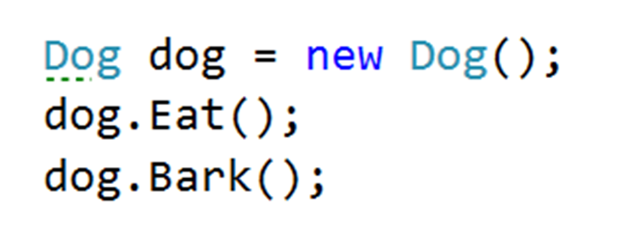
Problem: Single Inheritance
Animal
+Eat():void
Dog
+Bark():void
Notes:
Extensibility / Polymorphism: New functionality may be easily plugged in without changing existing classes as long the new plug-in classes extend given base classes.
Reusability: For a set of similar applications a framework can be defined using a core set of classes that are to be extended by classes that fill in the application-dependent part.
Information Hiding: If a more general class using a simpler contract is sufficient, details from extending classes may be hidden to some of the client classes. This allows them to be more independent from possible changes and diminishes the load of contracts that must be understood by a reader of these client classes.
(c) 2006 National Academy for Software Development - http://academy.devbg.org*
17##

Slide 18
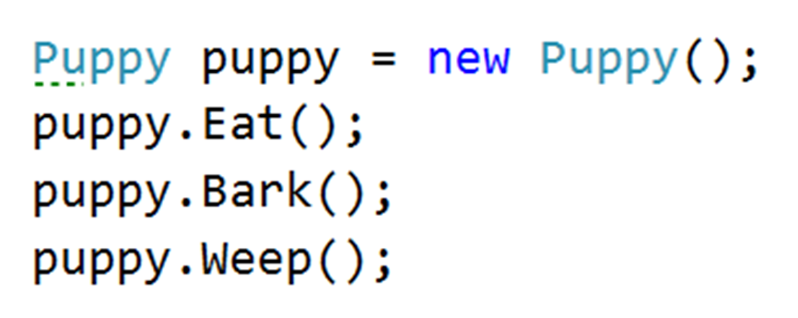
Problem: Multilevel Inheritance
Animal
+Eat():void
Dog
+Bark():void
Puppy
+Weep():void
Notes:
Extensibility / Polymorphism: New functionality may be easily plugged in without changing existing classes as long the new plug-in classes extend given base classes.
Reusability: For a set of similar applications a framework can be defined using a core set of classes that are to be extended by classes that fill in the application-dependent part.
Information Hiding: If a more general class using a simpler contract is sufficient, details from extending classes may be hidden to some of the client classes. This allows them to be more independent from possible changes and diminishes the load of contracts that must be understood by a reader of these client classes.
(c) 2006 National Academy for Software Development - http://academy.devbg.org*
18##

Slide 19
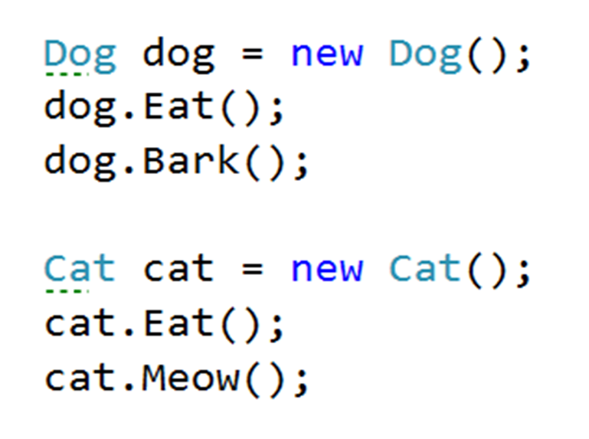
Problem: Hierarchical Inheritance
Animal
+Eat():void
Dog
Cat
-Bark():void
-Meow():void
Notes:
Extensibility / Polymorphism: New functionality may be easily plugged in without changing existing classes as long the new plug-in classes extend given base classes.
Reusability: For a set of similar applications a framework can be defined using a core set of classes that are to be extended by classes that fill in the application-dependent part.
Information Hiding: If a more general class using a simpler contract is sufficient, details from extending classes may be hidden to some of the client classes. This allows them to be more independent from possible changes and diminishes the load of contracts that must be understood by a reader of these client classes.
(c) 2006 National Academy for Software Development - http://academy.devbg.org*
19##

Slide 20

Reusing Classes
Reusing Code at Class Level

Slide 21
Inheritance and Access Modifiers
Derived classes can access all public and protected members
Derived classes can access internal members if in same assembly
Private fields are not inherited in subclasses (can't be accesssed)
class Person
{
private string id;
string name;
protected string address;
public void Sleep();
}
Can be accessed through other methods
Notes:
Extensibility / Polymorphism: New functionality may be easily plugged in without changing existing classes as long the new plug-in classes extend given base classes.
Reusability: For a set of similar applications a framework can be defined using a core set of classes that are to be extended by classes that fill in the application-dependent part.
Information Hiding: If a more general class using a simpler contract is sufficient, details from extending classes may be hidden to some of the client classes. This allows them to be more independent from possible changes and diminishes the load of contracts that must be understood by a reader of these client classes.
(c) 2006 National Academy for Software Development - http://academy.devbg.org*
21##

Slide 22
Shadowing Variables
Derived classes can hide superclass variables
class Person { protected int weight; }
class Patient : Person
{
protected float weight;
public void Method()
{
double weight = 0.5d;
}
}
Hides int weight
Hides float weight
Notes:
Extensibility / Polymorphism: New functionality may be easily plugged in without changing existing classes as long the new plug-in classes extend given base classes.
Reusability: For a set of similar applications a framework can be defined using a core set of classes that are to be extended by classes that fill in the application-dependent part.
Information Hiding: If a more general class using a simpler contract is sufficient, details from extending classes may be hidden to some of the client classes. This allows them to be more independent from possible changes and diminishes the load of contracts that must be understood by a reader of these client classes.
(c) 2006 National Academy for Software Development - http://academy.devbg.org*
22##

Slide 23
Shadowing Variables - Access
Use base and this to specify member access
class Patient : Person
{
protected float weight;
public void Method()
{
double weight = 0.5d;
this.weight = 0.6f;
base.weight = 1;
}
}
Local variable
Instance member
Base class member
Notes:
Extensibility / Polymorphism: New functionality may be easily plugged in without changing existing classes as long the new plug-in classes extend given base classes.
Reusability: For a set of similar applications a framework can be defined using a core set of classes that are to be extended by classes that fill in the application-dependent part.
Information Hiding: If a more general class using a simpler contract is sufficient, details from extending classes may be hidden to some of the client classes. This allows them to be more independent from possible changes and diminishes the load of contracts that must be understood by a reader of these client classes.
(c) 2006 National Academy for Software Development - http://academy.devbg.org*
23##

Slide 24
Virtual Methods
virtual – defines a method that can be overriden
public class Animal
{
public virtual void Eat() { … }
}
public class Dog : Animal
{
public override void Eat() {}
}
Notes:
Extensibility / Polymorphism: New functionality may be easily plugged in without changing existing classes as long the new plug-in classes extend given base classes.
Reusability: For a set of similar applications a framework can be defined using a core set of classes that are to be extended by classes that fill in the application-dependent part.
Information Hiding: If a more general class using a simpler contract is sufficient, details from extending classes may be hidden to some of the client classes. This allows them to be more independent from possible changes and diminishes the load of contracts that must be understood by a reader of these client classes.
(c) 2006 National Academy for Software Development - http://academy.devbg.org*
24##

Slide 25

Inheritance Benefits – Extension
We can extend a class that we can't otherwise change
Collections
List
Extends
CustomList
Notes:
Extensibility / Polymorphism: New functionality may be easily plugged in without changing existing classes as long the new plug-in classes extend given base classes.
Reusability: For a set of similar applications a framework can be defined using a core set of classes that are to be extended by classes that fill in the application-dependent part.
Information Hiding: If a more general class using a simpler contract is sufficient, details from extending classes may be hidden to some of the client classes. This allows them to be more independent from possible changes and diminishes the load of contracts that must be understood by a reader of these client classes.
(c) 2006 National Academy for Software Development - http://academy.devbg.org*
25##

Slide 26
Problem: Random List
Create an array list that has
All functionality of a List<string>
Function that returns and removes a random element
Collections
List<string>
+RandomElement():string
RandomArrayList
Notes:
Extensibility / Polymorphism: New functionality may be easily plugged in without changing existing classes as long the new plug-in classes extend given base classes.
Reusability: For a set of similar applications a framework can be defined using a core set of classes that are to be extended by classes that fill in the application-dependent part.
Information Hiding: If a more general class using a simpler contract is sufficient, details from extending classes may be hidden to some of the client classes. This allows them to be more independent from possible changes and diminishes the load of contracts that must be understood by a reader of these client classes.
(c) 2006 National Academy for Software Development - http://academy.devbg.org*
26##

Slide 27
Solution: Random Array List
public class RandomList : List<string>
{
private Random rnd; //TODO: Add ctor
public object RemoveRandomElement()
{
int index = rnd.Next(0, data.Count - 1);
string str = data[index];
data.RemoveAt(index);
return str;
}
}
Notes:
Extensibility / Polymorphism: New functionality may be easily plugged in without changing existing classes as long the new plug-in classes extend given base classes.
Reusability: For a set of similar applications a framework can be defined using a core set of classes that are to be extended by classes that fill in the application-dependent part.
Information Hiding: If a more general class using a simpler contract is sufficient, details from extending classes may be hidden to some of the client classes. This allows them to be more independent from possible changes and diminishes the load of contracts that must be understood by a reader of these client classes.
(c) 2006 National Academy for Software Development - http://academy.devbg.org*
27##

Slide 28
Types of Class Reuse
Extension, Composition, Delegation

Slide 29
Extension
Duplicate code is error prone
Reuse classes through extension
Sometimes the only way
Collections
List<string>
CustomList

Slide 30
Composition
Using classes to define classes
Laptop
class Laptop {
Monitor monitor;
Touchpad touchpad;
Keyboard keyboard;
…
}
Monitor
Touchpad
Reusing classes
Keyboard

Slide 31
Delegation
class Laptop
{
Monitor monitor;
void IncrBrightness()
monitor.Brighten();
void DecrBrightness()
monitor.Dim();
}
Laptop
increaseBrightness()
decreaseBrightness()
Monitor

Slide 32
Problem: Stack of Strings
Create a simple Stack class which can store only strings
StackOfStrings
StackOfStrings
-data: List<String>
List
+Push(string): void
+Pop(): string
+Peek(): string
+IsEmpty(): boolean
Notes:
Extensibility / Polymorphism: New functionality may be easily plugged in without changing existing classes as long the new plug-in classes extend given base classes.
Reusability: For a set of similar applications a framework can be defined using a core set of classes that are to be extended by classes that fill in the application-dependent part.
Information Hiding: If a more general class using a simpler contract is sufficient, details from extending classes may be hidden to some of the client classes. This allows them to be more independent from possible changes and diminishes the load of contracts that must be understood by a reader of these client classes.
(c) 2006 National Academy for Software Development - http://academy.devbg.org*
32##

Slide 33
Solution: Stack of Strings
public class StackOfStrings {
private List<String> data;
public void Push(string element)
{ this.data.Add(element); }
public string Pop()
{
var element = this.data.Last();
this.data.Remove(element);
return element;
}
}
TODO: Validate if list is not empty
Notes:
Extensibility / Polymorphism: New functionality may be easily plugged in without changing existing classes as long the new plug-in classes extend given base classes.
Reusability: For a set of similar applications a framework can be defined using a core set of classes that are to be extended by classes that fill in the application-dependent part.
Information Hiding: If a more general class using a simpler contract is sufficient, details from extending classes may be hidden to some of the client classes. This allows them to be more independent from possible changes and diminishes the load of contracts that must be understood by a reader of these client classes.
(c) 2006 National Academy for Software Development - http://academy.devbg.org*
33##

Slide 34
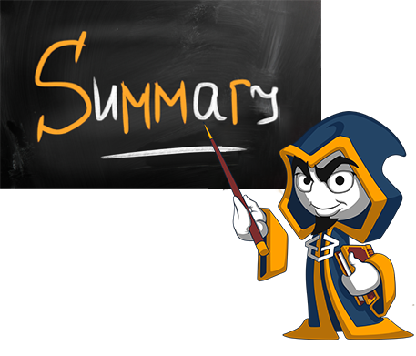
Summary
Inheritance is a powerful tool for code reuse
Subclass inherits members from Superclass
Subclass can override methods
Look for classes with the same role
Look for IS-A and IS-A-SUBSTITUTE relationship
Consider Composition and Delegation instead

Slide 35







Inheritance
https://softuni.bg/courses/csharp-oop-basics

Slide 36
License
This course (slides, examples, demos, videos, homework, etc.) is licensed under the "Creative Commons Attribution-NonCommercial-ShareAlike 4.0 International" license
Attribution: this work may contain portions from
"Fundamentals of Computer Programming with C#" book by Svetlin Nakov & Co. under CC-BY-SA license
"C# Part I" course by Telerik Academy under CC-BY-NC-SA license
"C# Part II" course by Telerik Academy under CC-BY-NC-SA license

Slide 37





Trainings @ Software University (SoftUni)
Software University – High-Quality Education, Profession and Job for Software Developers
softuni.bg
Software University Foundation
http://softuni.foundation/
Software University @ Facebook
facebook.com/SoftwareUniversity
Software University Forums
forum.softuni.bg

